Slide 1
Course: Cloud, Microservices & Application (ElectiveI )
UNIT I: INTRODUCTION
SESSION 1
Date: 14/7/2021

Slide 2
OUTLINE
Cloud Fundamentals
Cloud Computing reference model (NIST)
Characteristics of Cloud Computing (NIST)

Slide 3
Cloud Computing Fundamentals
Motivation for Cloud Computing
-Computing resources
-Expenditure
-Computing solution
-pay-per-use services

Slide 4
Need of Cloud Computing
-convenience and reliability
-accessibility
-security
etc...

Slide 5
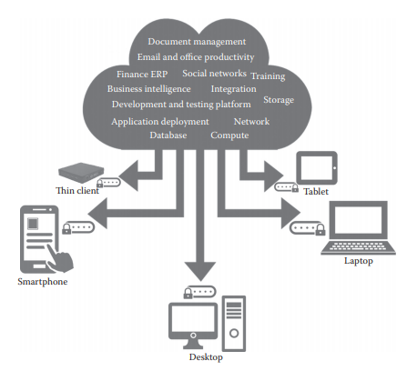
What is Cloud Computing?!
Image Source: K. Chandrasekaran, “Essentials of Cloud Computing”, 2nd Edition, CRC Press, 2015

Slide 6
NIST Definition of Cloud Computing
The formal definition of cloud computing comes from the National Institute of Standards and Technology (NIST):
Cloud computing is a model for enabling ubiquitous, convenient, on-demand network access to a shared pool of configurable computing resources (e.g., networks, servers, storage, applications, and services) that can be rapidly provisioned and released with minimal management effort or service provider interaction.
The cloud model are provided by 5-4-3 principles

Slide 7
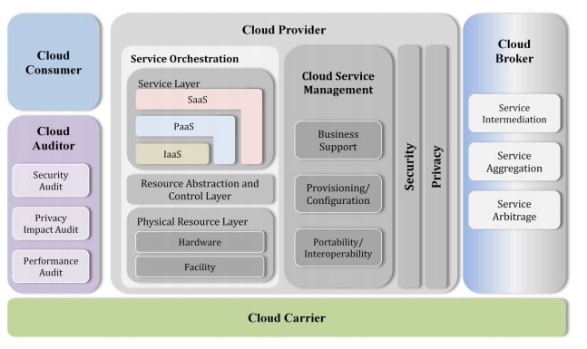
Cloud Computing Reference Model (NIST)
Image Source: https://nvlpubs.nist.gov/nistpubs/Legacy/SP/nistspecialpublication500-292.pdf

Slide 8
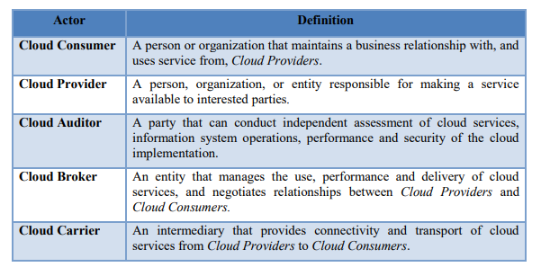
Actors in Cloud Computing
Information Source: https://nvlpubs.nist.gov/nistpubs/Legacy/SP/nistspecialpublication500-292.pdf

Slide 9
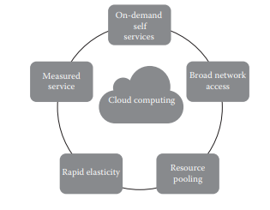
5-4-3 Principles of Cloud Computing
Five Essential Characteristics: word essential, which means that if any of these characteristics is missing, then it is not cloud computing
Image Source: K. Chandrasekaran, “Essentials of Cloud Computing”, 2nd Edition, CRC Press, 2015

Slide 10
On-demand self-service:
A consumer can unilaterally provision computing capabilities, such as server time and network storage, as needed automatically without requiring human interaction with each service’s provider.
Broad network access:
Capabilities are available over the network and accessed through standard mechanisms that promote use by heterogeneous thin or thick client platforms (e.g., mobile phones, laptops, and personal digital assistants [PDAs])

Slide 11
3. Elastic resource pooling:
The provider’s computing resources are pooled to serve multiple consumers using a multitenant model.
There is a sense of location independence in that the customer generally has no control or knowledge over the exact location of the provided resources but may be able to specify country, state, or data center etc.
Examples of resources include storage, processing, memory, and network bandwidth

Slide 12
4. Rapid elasticity:
Capabilities can be rapidly and elastically provisioned, in some cases automatically scaled up or scaled down
To the consumer, the capabilities available for provisioning often appear to be unlimited and can be purchased in any quantity at any time.

Slide 13
Measured service:
Cloud systems automatically control and optimize resource use
It can leverage by a metering capability at some level of abstraction appropriate to the type of service (e.g., storage, processing, bandwidth, and active user accounts).
Resource usage can be monitored, controlled, and reported providing transparency for both the provider and consumer of the utilized service.

Slide 14
Any Questions???

Slide 15
Thank You

